Slide 1

校園故事
(Animaze)

Slide 2
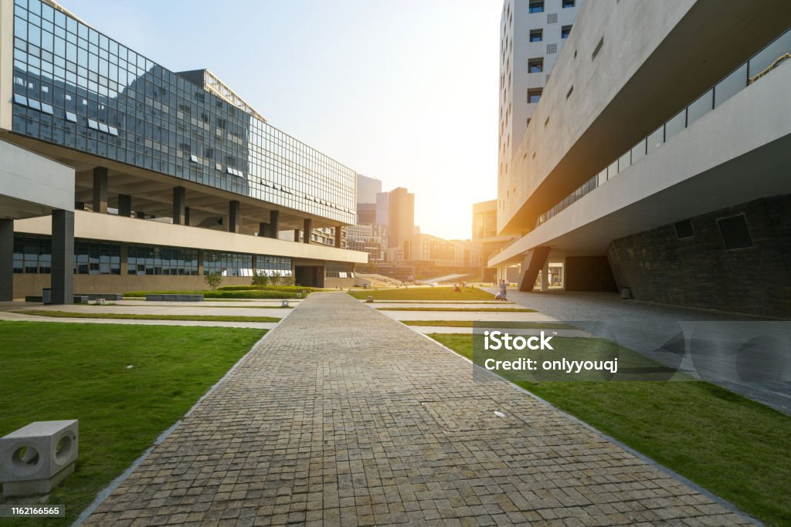
1.目標
Notes:
campus scenery

Slide 3

2.阻礙
Notes:
technical challenges

Slide 4

3.努力
Notes:
Overcome programming challenges

Slide 5

4.結果
Notes:
Won everyone's recognition

Slide 6
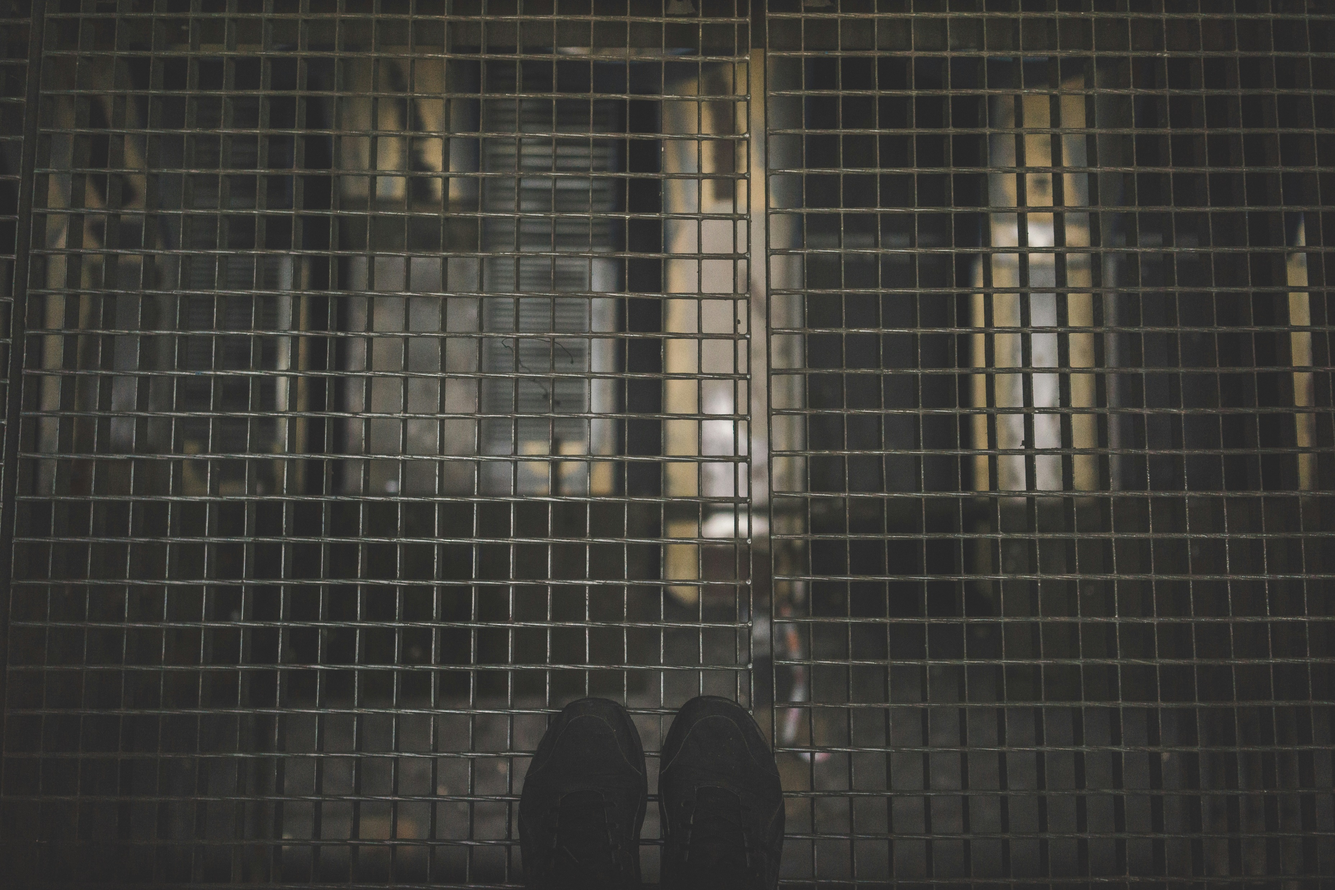
5.意外
Notes:
Unable to meet all needs, high pressure

Slide 7

6.轉彎
Notes:
Start collaborating with teachers and classmates outside school

Slide 8

7.結局
Notes:
Complete graduate studies

